Slide 1
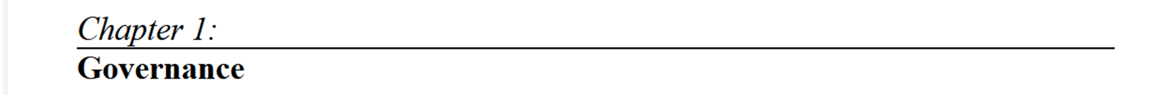


Slide 2

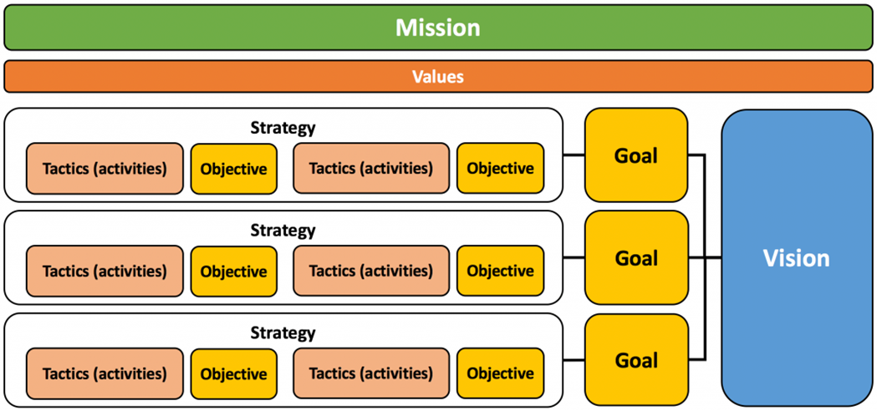
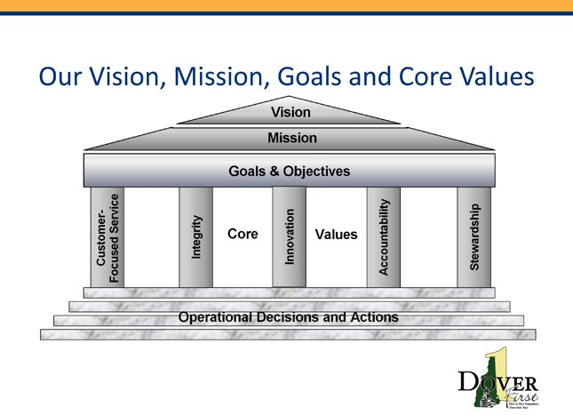
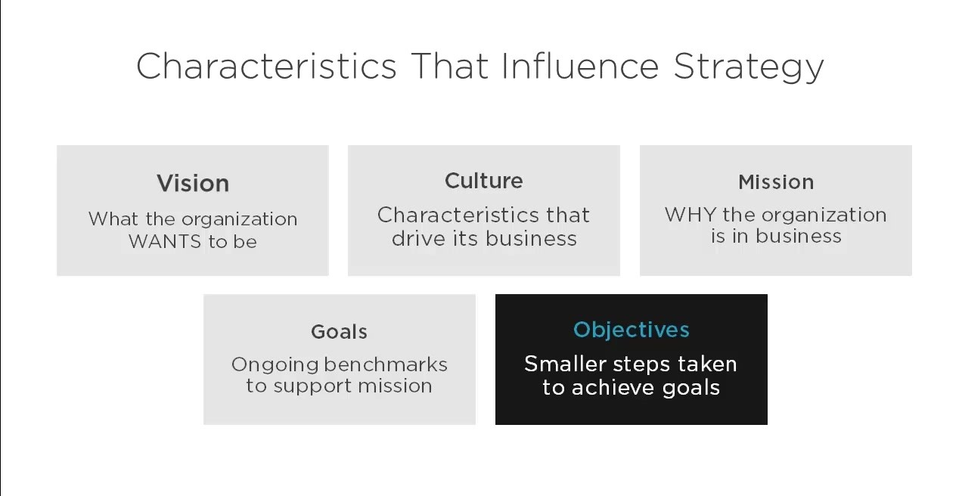
We define Strategic Vision as “What the organization hopes to become — the business you will be in tomorrow.”
is a long-term, comprehensive picture of an organization's goals and the Objectives

Slide 3
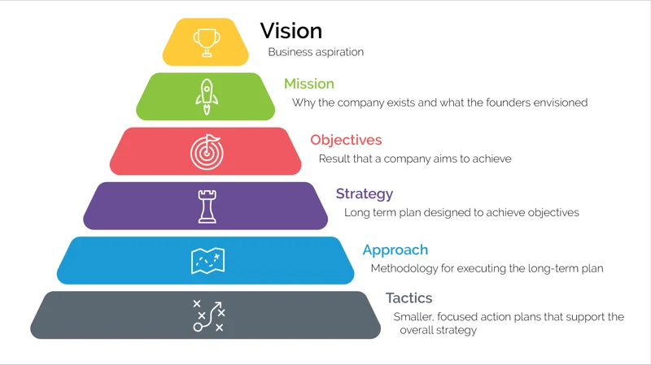
Goals, Mission, and Objectives
  Goals—statements describing what your organization wishes to accomplish. Goals are the ends toward which your efforts will be directed and often change from term to term or year to year.
  Organizations cannot survive for a very long time without some basic goals. Goals give an organization a purpose and direction to move towards the entire year.
  Examples of strategic goals for finance:
    Create and launch new product(s)
    Become market leader
    Customer satisfaction
    Gain market position
    Explore new customer segments
    Increase revenues
    Attract investment
    Return on Assets
    Number of products in portfolio

Slide 4
Examples of strategic goals for learning and growth:
  Improve internal communications
  Number of Reporting tools
  Communication skills training programs
  Surveying your teams (monthly survey?)
  Open new locations
  Number of locations per city/region/country
  Going international
Examples of strategic goals for customers:
  Improve customer satisfaction
  Decrease the number of product returns
  Response time to complaints
  Improve our service approach for new and existing customers.
  Strategic partnerships
  Customer Delivery time
  Increase in new customers
Examples of strategic goals for business processes:
  Restructure organization
  Grow through acquisition
  Increase value of projects and manage growth
  Lower production costs
  Build capacity for the future
  Decrease defects
  Improve supplier relationships

Slide 5
  The organizational mission refers to a statement of its ongoing purpose and reason for existence.
  The mission statement should guide the actions of the organization, explain its overall goal, provide a path to achieve this goal, and guide the management in decision-making.
  An organization usually publishes its mission statement, so that its employees, customers, suppliers, and partners are aware of the organization’s stated purpose.
  As an example of an organization’s mission statement, let us look at the mission statement of ISC² which is
        “To Support and provide members and constituents with credentials, resources, and leadership to secure information and deliver value to society.”

Slide 6
Mission Statement Examples
Microsoft (at its founding): A computer on every desk and in every home.
Australia Department of Health: Better health and wellbeing for all Australians, now and for future generations.
LinkedIn: Create economic opportunity for every member of the global workforce.
Facebook: Connect with friends and the world around you on Facebook.
American Express: We work hard every day to make American Express the world's most respected service brand.
JetBlue: To inspire humanity – both in the air and on the ground.

Slide 7
Objectives—descriptions of exactly what is to be done, derived from the goals.
They are clear, specific statements of measurable tasks that will be accomplished as steps toward reaching your goals. They are short term and have deadlines.
Objectives are observable and measurable. People can determine whether the organization has met its objectives.
Top 10 Most Important Business Objectives
  Getting and Staying Profitable
  Productivity of People and Resources
  Excellent Customer Service
  Employee Attraction and Retention
  Mission-driven Core Values
  Sustainable Growth
  Maintaining a Healthy Cash Flow
  Dealing with Change
  Reaching the Right Customers
  Staying Ahead of the Competition

Slide 8

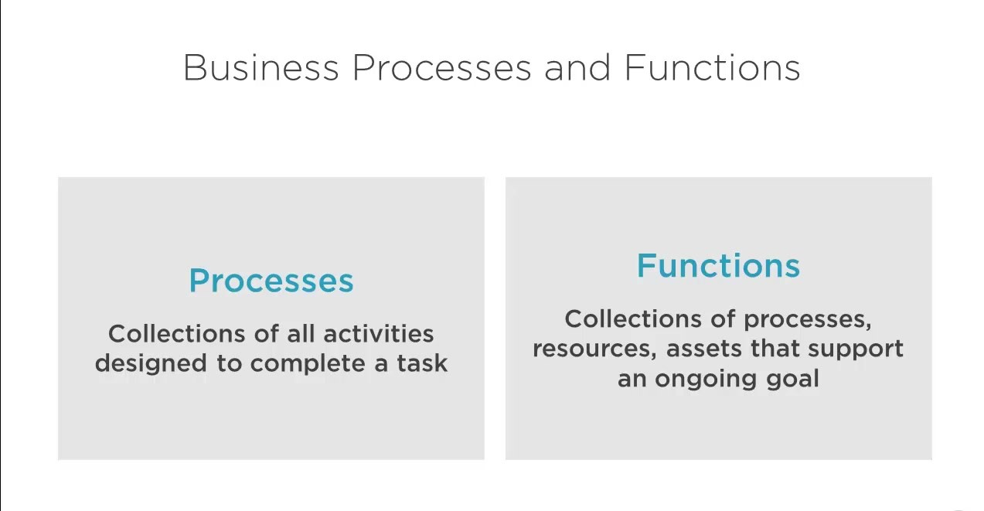

Slide 9
  A business process is a collection of linked tasks which find their end in the delivery of a service or product to a client. A business process has also been defined as a set of activities and tasks that, once completed, will accomplish an organizational goal.
Business processes categories
  Depending on the organization, industry and nature of work, business processes are often broken up into different categories. These categories include:
  1. Operational processes -- or primary processes:
    These processes deliver value to the customer by producing a product or service.
  2. Supporting processes -- or secondary processes:
    Examples of supporting processes include accounting, HR management and workplace safety.
    One key differentiator between operational and support processes is that support processes do not provide value or product to customers directly.
  3. Management processes:
    Management processes measure, monitor and control the activities related to business procedures and systems.
    Examples of management processes include internal communications, governance, strategic planning, budgeting, and infrastructure or capacity management.
    Like supporting processes, management processes do not provide value directly to the customers.

Slide 10
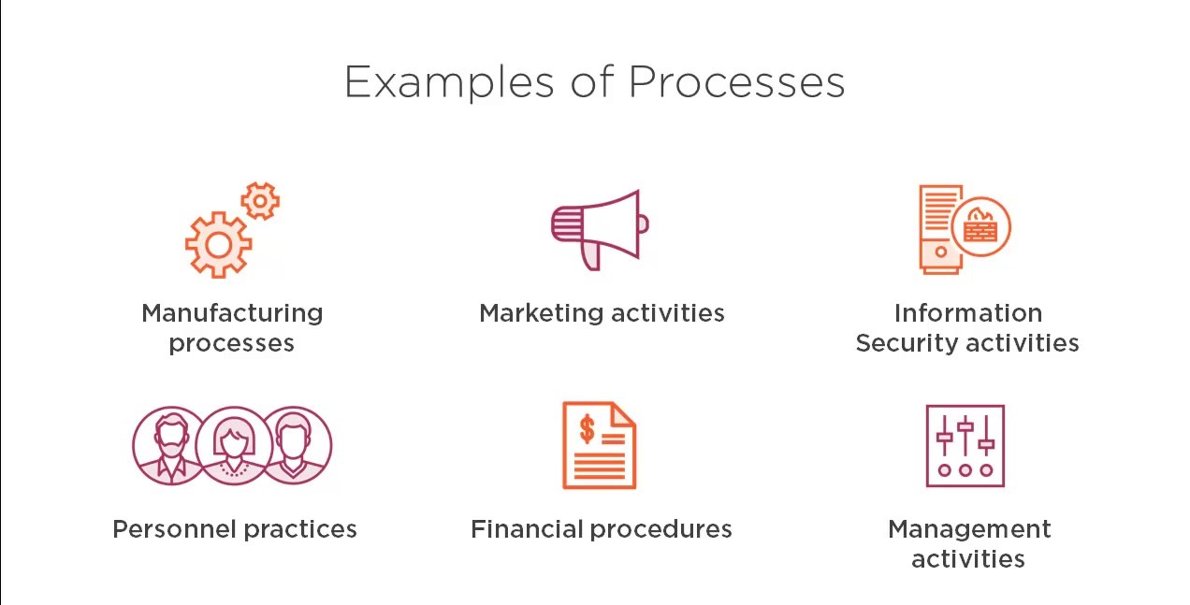

Slide 11
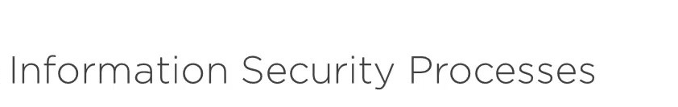
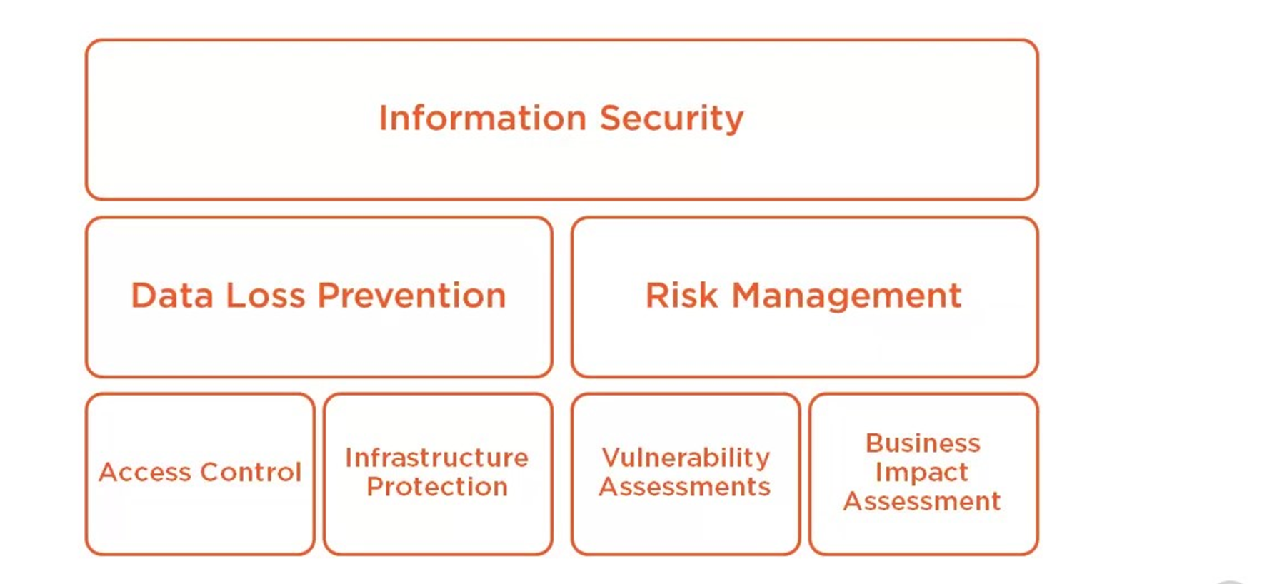

Slide 12
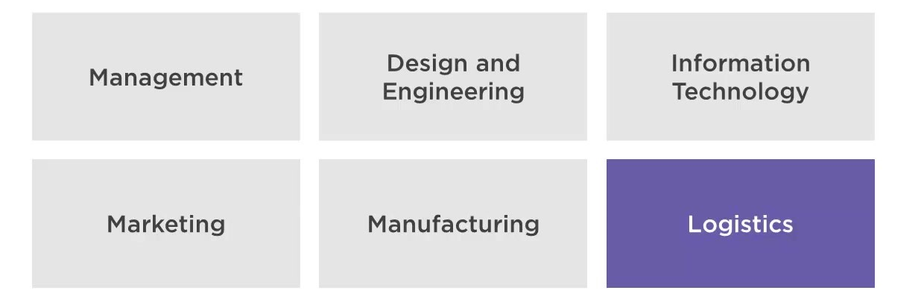
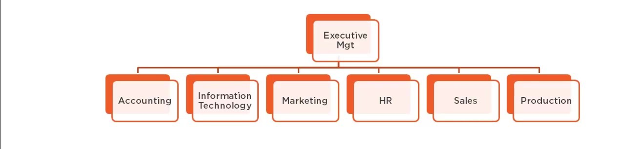

Slide 13
Management Levels
Top-level Management
  High level managers tend to have a substantial amount of experience, ideally across a wide variety of functions. This include Chief Operations Officer (COO), Chief Marketing Officer (CMO), Chief Technology Officer (CIO or CTO), Chief Financial Officer (CFO) or Chief Executive Officer (CEO).
the role of the top management can be summarized as follows -
  It prepares strategic plans & policies for the enterprise.
  It issues necessary instructions for preparation of department budgets, procedures, schedules etc.
  It controls & coordinates the activities of all the departments.
  It is also responsible for maintaining a contact with the outside world.
  It provides guidance and direction.
  The top management is also responsible towards the shareholders for the performance of the enterprise.

Slide 14
Middle Level of Management
  Middle-level managers can include general managers, branch managers, and department managers. They are accountable to the top-level management for their department’s function, and they devote more time to organizational and directional functions than upper management.
Their role can be emphasized as -
  They execute the plans of the organization in accordance with the policies and directives of the top level management.
  They make plans for the sub-units of the organization.
  They participate in employment & training of lower level management.
  They interpret and explain policies from top level management to lower level.
  They are responsible for coordinating the activities within the division or department.
  It also sends important reports and other important data to top level management.
  They evaluate performance of junior managers.
  They are also responsible for inspiring lower level managers towards better performance.

Slide 15
Front Line Management
  At the front line, managers are often highly skilled and even functional specialists like supervisors, foreman, section officers, superintendent
  First-line managers are responsible for the daily management of line workers which is the employees who actually produce the product or offer the service.
  These are the managers that most employees interact with on a daily basis, and if the managers perform poorly, employees may also perform poorly, may lack motivation, or may leave the company
Their activities include -
  Assigning of jobs and tasks to various workers.
  They guide and instruct workers for day to day activities.
  They are responsible for the quality as well as quantity of production.
  They communicate workers problems, suggestions, and recommendatory appeals etc to the higher level and higher level goals and objectives to the workers.
  They are responsible for providing training to the workers.

Slide 16
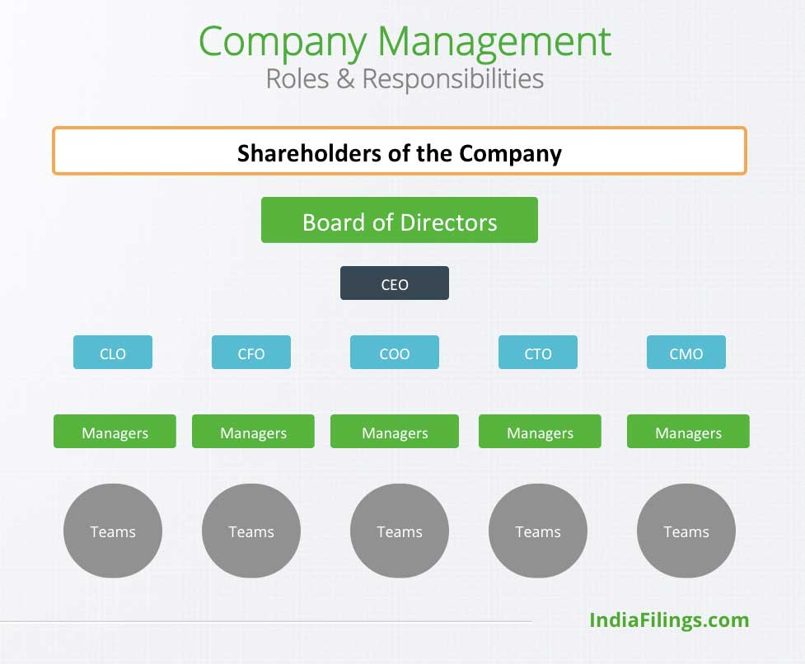
What is a shareholder?
  A shareholder is anyone who owns at least one share of a company's stock.
What is a board of directors?
  A board of directors, is a group of people elected by a company's shareholders to represent their interests.
  The board acts as a governing body for a company or corporation.
  Their primary goal is to protect the assets of the shareholders by ensuring an organization's management acts on their behalf and that they get a good return on their investment (ROI) in the company.
  All public companies are required to have a board of directors that includes members from inside and outside the organization.

Slide 17
What does a board of directors do?
A board of directors primarily functions as a fiduciary, acting on behalf of the organization's shareholders.
A fiduciary (مستشار توزيع أصول) is bound legally and ethically to act in their best interests of the shareholders.
“Director” is the general term for those who serve on the board.
Board members make decisions about issues, such as:
  Hiring and firing senior executives
  Creating share policies and payouts [paid regularly (typically quarterly) by a company to its shareholders out of its profits ]
  Establishing stock option policies
  Leading acquisitions and mergers
  Responding to crises within the company
  Setting company goals
  Supporting executive duties
  Providing necessary resources

Slide 18
Board size
  The size of the board of directors depends on the needs of the company. However An uneven number is recommended to avoid tie votes.
  Many analysts claim that seven is the ideal number of members for a board.
  No matter the number, the directors should represent the interests of both the shareholders and management with external and internal members.
Outside vs. inside directors
  On a board, there are typically two types of directors that each fulfill different roles:
Outside directors
  Outside directors bring an independent view to company issues, as they aren't involved in the company's daily operations.
  Companies choose outside directors for their expertise in associated business fields.
  Since they are not a company employee, they get pay to attend meetings.
Inside directors
  Inside directors are company employees whose experience brings value to the board.
  Unlike outside directors, these individuals don't receive compensation, as they're already a member of the company and likely receive a regular salary instead.
  Some popular roles that serve as inside directors on a board include a C-level executive, major shareholder or a union representative.

Slide 19
Types of board members
  They typically include:
  Chairperson: Sometimes referred to as a “chairman” or “president,” the chairperson is the acting head of the board of directors. While the chairperson sets the direction for the board, all board members serve as peers, with many companies choosing CEOs as chairpersons.
  Vice chairperson: Sometimes referred to as “vice president,” the vice chairperson serves in the chairperson's absence.
  Treasurer: The treasurer handles the company's financial health but does not take responsibility for day-to-day operations. They typically manage the annual budget, financial policies, investments and financial audits.
  The executive director is an inside director that holds an executive position within the organization. This may be someone who works as a CEO or in another leading role.
What to look for in a board member
A company can look for the following characteristics when recruiting new board members:
    Expertise in a specific area that gives value to the company. For example, many boards include lawyers and financial specialists
    Leadership and management experience, especially in related businesses
    Commitment to the company and interest in its continued well-being
    Commitment to serve by providing the time and energy to devote to their board duties
    Integrity and lack of conflict of interest

Slide 20
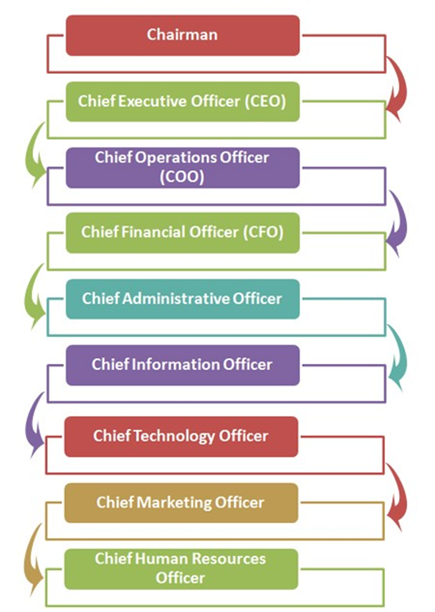
Chairman
  The presiding person leading the business and possessing the highest authority in the company is chairman.
  The chairman leads and influences the board of the directors and chief officers to manage the financial, human, technical and environmental working of a corporation.
Chief Executive Officer (CEO)
  The CEO is also referred as an executive chairman and takes the command in hand in absence of the chairman. CEO is the top ranking in the executive officers rank.
Chief Operations Officer (COO)
  The chief operation officer is normally following CEO rank.
  A COO can be explained as a director of operations in the corporate sector with a responsibility of handling and managing the daily operations of the organization.
  The professionals at this level focus on the organizational strategy, objectives and plan of actions to be followed.
  The day today management of organization is also carried out at this level.
Chief Financial Officer (CFO)
  A chief financial officer is a corporate officer designated at a high level in the corporate hierarchy for the purpose of managing finances for the organization.
  A CFO is directed to report to the CEO. In some organizations the term Treasures is used to define the CFO.

Slide 21
Chief Administrative Officer (CAO)
  As the designation implies, a CAO is basically responsible for handling and organizing administrative management of the corporations.
  CAO rank is considered one of the highest level ranks in the corporate rank hierarchy.
Chief Information Officer (CIO)
  A CIO is a senior level in the corporate rank hierarchy responsible for the maintenance and establishment of the organization’s strategy to ensure that the company’s information and data assets are protected adequately.
Chief Technology Officer (CTO)
  CTO is sometimes also termed as a chief technical officer. This is among the high level ranks in hierarchy mainly responsible for managing company’s technology department along with research and development process.
Chief Marketing Officer (CMO)
  CMO is a title designated to a professional whose responsibility is to manage different marketing activities in the corporation.
  CMO reports directly to a chief executive officer. This is a mid-level rank in the hierarchy.
Chief Human Resources Officer (CHRO)
  CHRO is a mid-level rank in the hierarchy taking care of the human resources department for the corporation. CHRO reports to the chief executive officer only.

Slide 22

Types of Board Committees
  1. Establish committees when it's apparent that issues are too complex and/or numerous to be handled by the entire board.
  2. For ongoing, major activities establish standing committees; for short-term activities, establish ad hoc committees that cease when the activities are completed.
  3. Committees recommend policy for approval by the entire board.
  4. Committees make full use of board members' expertise, time and commitment, and ensure diversity of opinions on the board.
  5. Committees may meet monthly (this is typical to new organizations, with working boards), every two months, or every three months.
  7. Have at least two board members on each committee, preferably three
  8. Don't have a member on more than two committees

Slide 23
Audit Committee
  the Audit Committee is quickly becoming a standing committee at many organizations.
  It is usually a small committee of three to five members. Its work is often seasonal, tied to the end of the organization’s financial year.
  The Audit Committee selects the outside auditor, meets with the auditor to receive the audit report and management letter.
  Members of the Audit Committee should be financially literate and at least one (and preferably more) should be financial professionals.
  While there may be some overlap in membership with the Finance Committee, the chair of the Finance Committee should not be on the Audit Committee. Likewise, the chair of the board and the CEO should not be on the Audit Committee.
Public Relations committee
  Represents the organization to the community; enhances the organization's image, including communications with the press
Finance Committee
Oversees development of the budget; ensures accurate tracking/monitoring/accountability for funds.
ensures adequate financial controls; often led by the board treasurer.
reviews major grants and associated terms

Slide 24
Security Steering Committee
Many organizations form a security steering committee, consisting of stakeholders from many (if not all) of the organization’s business units, departments, functions, and principal locations.
A steering committee may have a variety of responsibilities, including the following:
  Risk treatment and recommendation
    The security steering committee may discuss relevant risks, discuss potential avenues of risk treatment
  Discussion and coordination of IT and security projects
    The security steering members may discuss various IT and security projects to resolve any resource or scheduling conflicts.
  Review of recent risk assessments
    The security steering committee may discuss recent risk assessments in order to develop a common understanding of their results, as well as discuss remediation of findings.
  Discussion of new laws, regulations, and requirements
    Committee members can develop high-level strategies that their respective business units or departments can further build out.

Slide 25
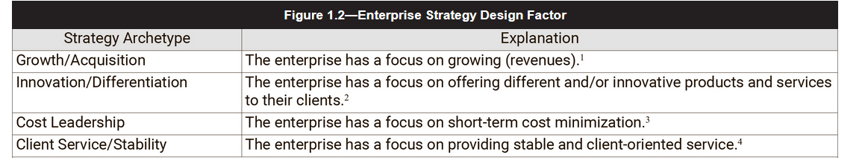
Organizational Strategy
  So how does an enterprise identify its strategy? COBIT proposes the four strategic archetypes to help describe strategies (figure 1.2).
Understanding the strategy archetype allows the enterprise to align risk governance processes and ensure that risk efforts are evaluated, directed and monitored in the proper context.
This requires the enterprise governing body to ensure that the risk appetite and risk tolerance are understood and that they are communicated throughout the enterprise.
This, in turn, establishes the goals of risk management capabilities.

Slide 26
At a high-level, the goals for risk practitioners is to:
  Provide accurate, complete and timely information required to make the best, most well-informed decision possible by senior management.
  Identify, assess and advise, with the appropriate response, the risk that has the highest likelihood of occurrence and/or ability to impact the enterprise ability to successfully achieve its goals and objectives.
  Allow for the ability to balance performance and conformance requirements that best suit the enterprise through the activities previously described.

Slide 27
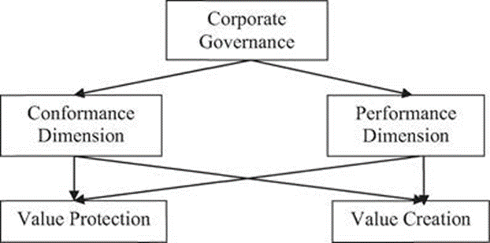
Organizational Governance
  At its core, governance is the ability to meet stakeholder needs by providing value.
  This is achieved through the proper balancing of both performance and conformance requirements defined by the enterprise and only accomplished by ensuring that a proper risk-management capability is in place.
  Having a well-defined risk-management program ensures that enterprises are able to identify, analyze, evaluate, assess and respond to those threats that pose the greatest risk.
Conformance is about achieving good governance by acting within the laws, regulations, rules and codes.
Performance responsibilities focus on strategy, value creation and resource utilization, enhance business activities to affect revenue, shareholder and stakeholder value.

Slide 28
Avoid paying too much attention on compliance:
  Most organizations are wasting valuable time and resources focusing more on compliance at the expense of strategic planning and execution, performance improvement and growing their enterprises.
  Compliance alone is not sufficient to ensure long-term organizational success hence the need to spend enough time and resources on strategy and performance.
Fully integrate good governance into the organization:
  This is more than a compliance exercise. Governance should form part of the organization’s DNA and spread through all facets of the organization.
  Thus, governance principles should be taken into account when planning, implementing and reviewing the organization’s objectives.
  The organization as a whole and every individual within the organization is responsible for good governance and helping the organization achieve its objectives.
  How else can an organization successfully create a balance between performance and conformance and achieve positive enterprise results?

Slide 29
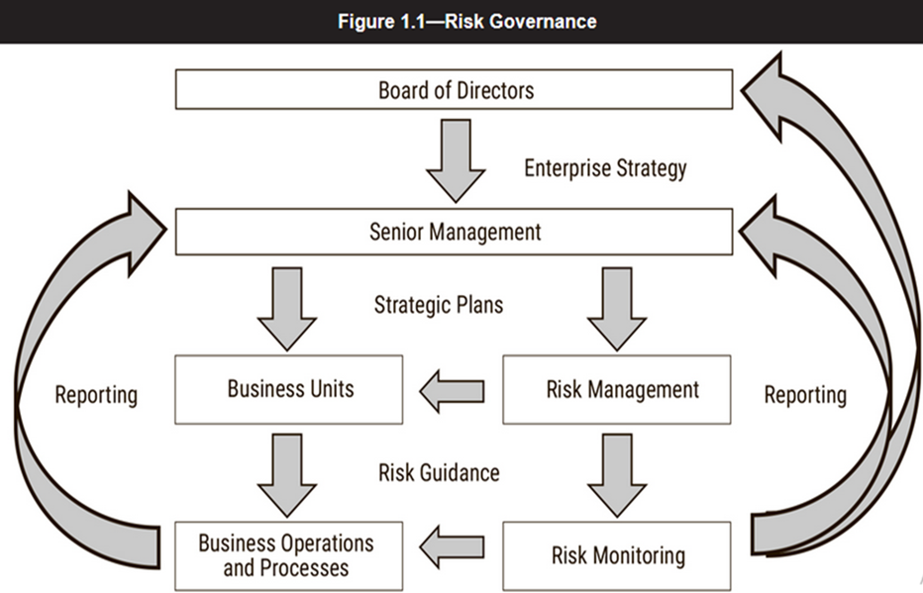
overview of the risk governance structure.
In a corporate structure, the directors of an enterprise(frequently organized as a board) are accountable for governance and entrust the senior management team with the responsibility to manage the day-to-day operations in alignment with the strategic direction that the directors approve.
Risk management functions-- the processes, practices and activities which fall within Risk management need to be sufficiently governed to ensure continued alignment with the enterprise goals and objectives.
governing body sets the enterprise strategy and direction relating to risk management capabilities including Risk management policy and Risk appetite
Risk governance applies the principles of good governance to the identification, assessment, management and communication of risks.
This communication ensures that risk-management processes, practices and activities are properly aligned and become part of business processes and are embedded within the normal routine and operations within the enterprise.

Slide 30
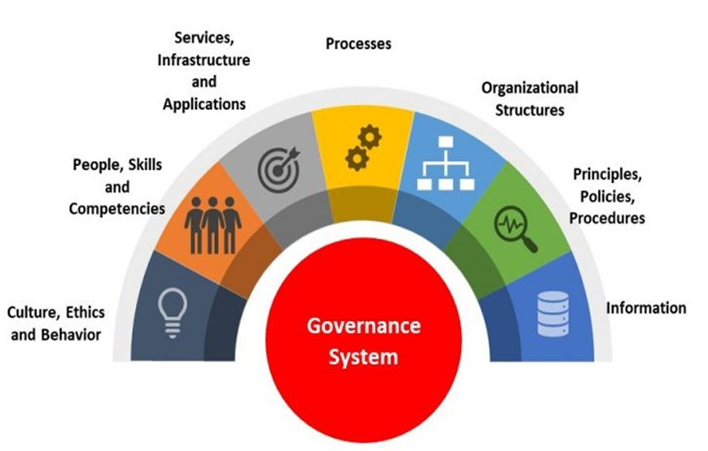
Risk management is the keystone of governance.
Corporate governance is the system by which organizations evaluate, direct, monitor and ultimately control an enterprise.
The objective of any governance system is to enable enterprises to create value for their stakeholders or to promote the creation of value.
risk optimization is essential for the success of any governance system and cannot be isolated, as an enterprise will not be able to properly plan and optimize resources, nor realize benefits, without proper governance and risk management.
Governance answers four questions:
    Are we doing the right things?
    Are we doing them the right way?
    Are we getting them done well?
    Are we seeing expected benefits?
There is a distinction between the governance and management functions. Management activities focus on planning, building, running and monitoring to ensure proper and continued alignment with the defined goals and objectives established by the governing body.

Slide 31
Risk governance applies the principles of good governance to the identification, assessment, management and communication of risks ( what is a good governance ….The board of directors must act following the four principles of governance — accountability, transparency, fairness and responsibility — for the best interest of stakeholders, shareholders and the business as a whole.)
Risk Governance objectives: Ensure that risk management practices are embedded in the enterprise
The four core objectives of Risk Governance are :
    RG1 Establish and Maintain a Common Risk View
      Perform enterprise risk assessment
      Propose risk tolerance and Appetite thresholds
      Approve risk tolerance and Appetite
      Promote risk-aware culture
      Encourage effective communication of risk
    RG2 Integrate With ERM
      Establish and maintain accountability for risk management
      Coordinate risk strategy and business strategy
      Provide adequate resources for risk management
    RG3 Make Risk-aware Business Decisions
      Gain management buy-in for the risk analysis approach
      Approve risk analysis
      Embed risk consideration in strategic business decision making
    RG4 Ensure that Risk Management Control are implement and operating Correctly

Slide 32
Risk management starts with understanding the enterprise, but the risk practitioner should bear in mind that the enterprise is heavily influenced by the environment (internal and external) and/or context in which it operates.
when Assessing an enterprise's context the factors to consider include:
  Dependency of the enterprise on third parties
  Vulnerability to changes in economic or political conditions
  Changes to market trends and patterns
  Emergence of new competition
  Emergence of new, disruptive technologies
  Impact of new legislation
  Existence of potential natural disaster
  Constraints caused by legacy systems and outdated technology

Slide 33
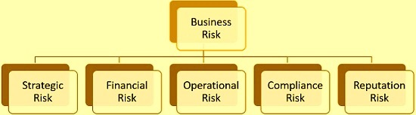
Main Types of Business Risks
Strategy risks – Risks arising from identifying and pursuing a strategy, which is poorly defined, is based on inaccurate data or fails to support the delivery of commitments, plans or objectives due to a changing environment (e.g. political, economic, social, technological, environment and legislative change).
Governance risks – Risks arising from unclear plans, priorities, authorities and accountabilities, and/or ineffective or disproportionate oversight of decision-making and/or performance.
Operations risks – Risks arising from inadequate, poorly designed or ineffective/inefficient internal processes resulting in fraud, error, impaired customer service (quality and/or quantity of service), non-compliance and/or poor value for money.
Legal risk threatens a company should the company face lawsuit or penalty for contractual, dispute, or regulatory issues. An example of legal risk is a billing dispute with a major customer.
Compliance risk threatens a company due to a violation of external law or requirement. An example of compliance risk is a company's inability to produce timely financial statements in accordance with applicable accounting rules such as GAAP (Generally accepted accounting principles).

Slide 34
Property risks – Risks arising from property deficiencies or poorly designed or ineffective/ inefficient safety management resulting in non-compliance and/or harm and suffering to employees, contractors, service users or the public.
Financial risks – Risks arising from not managing finances in accordance with requirements and financial constraints resulting in poor returns from investments, failure to manage assets/liabilities or to obtain value for money from the resources deployed, and/or non-compliant financial reporting.
Commercial risks – Risks arising from weaknesses in the management of commercial partnerships, supply chains and contractual requirements, resulting in poor performance, inefficiency, poor value for money, fraud, and /or failure to meet business requirements/objectives.
People risks – Risks arising from ineffective leadership and engagement, suboptimal culture, inappropriate behaviors, the unavailability of sufficient capacity and capability, non-compliance with relevant employment legislation/HR policies resulting in negative impact on performance.

Slide 35
Technology risks – Risks arising from technology not delivering the expected services due to inadequate or deficient system/process development and performance or inadequate resilience.
Information risks – Risks arising from a failure to produce robust, suitable and appropriate data/information and to exploit data/information to its full potential.
Security risks – Risks arising from a failure to prevent unauthorized and/or inappropriate access to key government systems and assets, including people, platforms, information and resources. This encompasses the subset of cyber security.
Project/Programme risks – Risks that change programmes and projects are not aligned with strategic priorities and do not successfully and safely deliver requirements and intended benefits to time, cost and quality.
Reputational risks – Risks arising from adverse events, including ethical violations, a lack of sustainability, systemic or repeated failures or poor quality or a lack of innovation, leading to damages to reputation and or destruction of trust and relations.

Slide 36
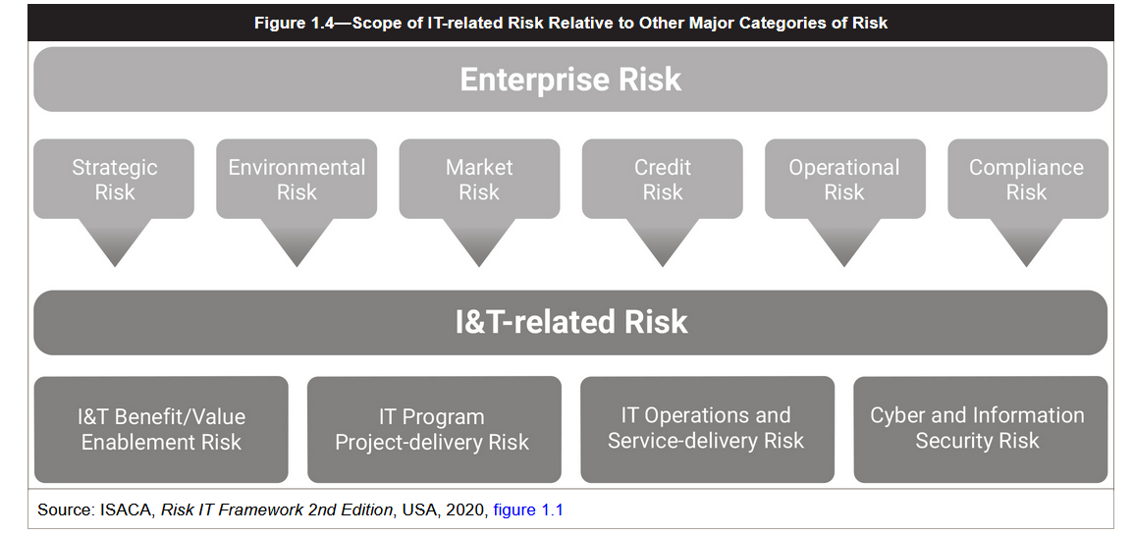
  Figure 1.4 illustrates how IT risk relates to overall risk of the enterprise.

Slide 37
Risk is an influencing factor and must be evaluated at all levels of the enterprise the strategic level, the business unit level and the information systems level.
A properly-managed risk program addresses the impact of risk at all levels and describes how risk at one level may affect the other levels.
IT risk management is the implementation of a risk strategy that reflects the culture, appetite and tolerance levels of risk from organizational management; considers resources, maturity, technology and budgets; and addresses business requirements stemming from regulatory, statutory and contractual compliance drivers.
An effective IT risk management strategy is critical to an enterprise ability to execute its overall business strategy effectively and efficiently.

Slide 38
  IT risk management is a cyclical process. The first step in the IT risk-management process is the identification of IT risk, which includes determining the risk context and risk framework, the enterprise risk appetite and tolerance levels and the process of identifying and documenting risk.
    The risk identification effort should result in the listing and documentation of the threats posed to organizational assets, usefulness of existing controls, any personnel, processes and technology that may be vulnerable or have a perceived weakness and the potential harm introduced should the threat be realized, which serves as the input for the next phase of the process, IT risk assessment.
    The Risk assessment effort requires the analysis and evaluation of threats in order to then assess and prioritize risk in context of the enterprise defined risk appetite and criteria for deviations where risk tolerances would be increased.
    This provides management with the information needed for the Risk response and mitigation, the third phase of the cycle, which seeks and implements cost-effective ways to address the risk that has been identified and assessed.
    The final phase is the Risk and control monitoring and reporting, in which controls, risk management efforts and the current risk state are monitored, and the results reported back to senior management.
  The IT risk-management process is based on the complete cycle of all the elements. A failure to perform any one of the phases in a complete and thorough manner may result in deficiencies being carried forward that cause the overall process to be ineffective.
  The process repeats as the risk environment changes, which may occur as a result of internal or external factors.
  Figure 1.5 illustrates the cyclical IT risk-management process.

Slide 39
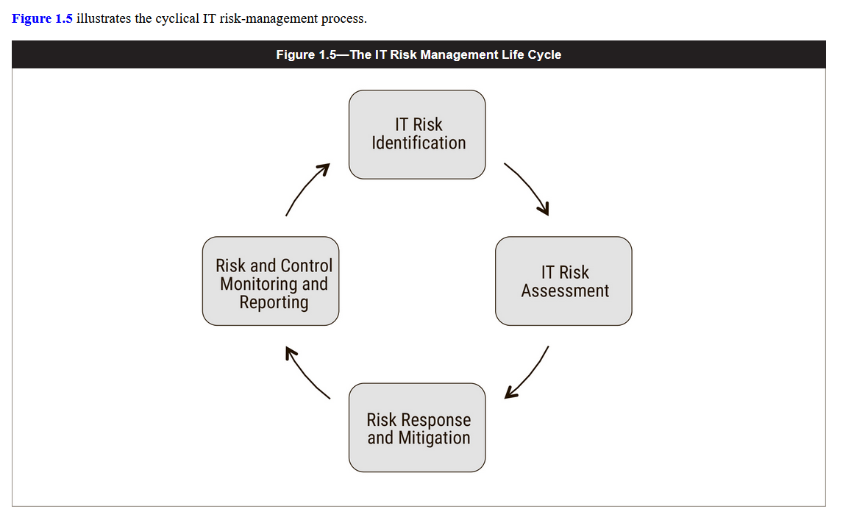

Slide 40
Key Concepts of Risk
The fundamental nature of risk is that it addresses the probability that some event will happen (likelihood) and what it would mean for the enterprise if that event did happen (impact/consequence).
Early attempts to define risk observed that the probability of something happening was a combination of two things: whether something was attempted (threat) and whether the target of the attempt was susceptible to what was tried (vulnerability).
It is now common to distinguish between different types of threats, evaluating them on the basis of organizational assets that they may be directed towards, but also unique threat actors that may attempt to exploit any perceived weaknesses or discovered vulnerabilities associated with the asset.
This results in the ability to speak about specific threat scenarios in context.
When viewed from the perspective of how these assets are used within the enterprise, it becomes possible to quantify impact in terms of:
    Productivity cost
    Response costs
    Legal cost (fines/penalties/summary judgements)
    Competitive advantage
    Damaged reputation/brand impact cost
    Health, safety, security and environment concerns
This is useful, and of added benefit, for two reasons:
  It is easier for managers to set a monetary value of total losses that they are willing to incur (risk appetite) than it is to define what consequences are or are not acceptable in a dozen or more different areas of operations.
  Knowing the potential losses associated with risk provides a basis for deciding how to respond to risk that is beyond acceptable levels because it does not make sense to spend more to respond to a risk than the cost the risk itself presents.

Slide 41
Importance and Value of IT Risk Management
IT risk management is important to the organization because of the benefits that the program delivers, such as the following:
    Better oversight and understanding of organizational assets
    Reduced or minimized losses
    Identification of threats, vulnerabilities and consequences on a proactive basis
    Prioritization of risk response efforts that align with organizational goals and priorities
    more holistic basis for and approach to legal and regulatory compliance
    Increased likelihood of project success
    Improved performance
    Greater stakeholder confidence
    Creation of a risk-aware culture with less reliance on specialists
    Better incident, business continuity management, and overall organizational resiliency
    Improved control selection and implementation
    Monitoring and reporting that is meaningful to the organization
    Improved decision making as a result of expanded
    access to accurate, timely information
    An increased ability to meet business objectives and create value

Slide 42
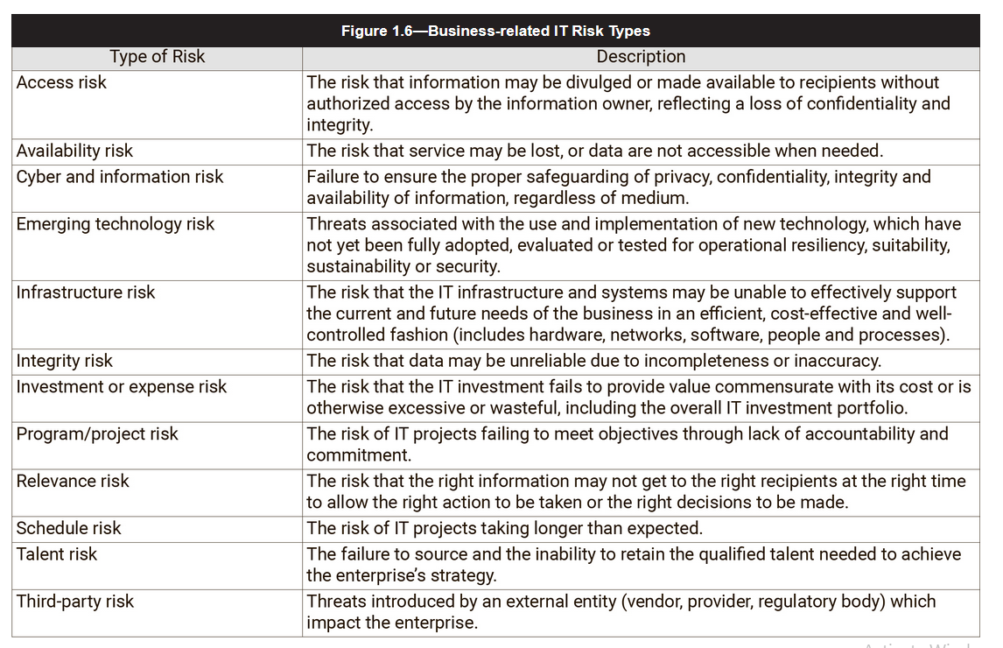
Types of business Related IT Risk
The risk practitioner should always recognize that what is critical to IT may or may not be the most critical consideration of the organization in the context of overall risk.

Slide 43
Senior Management Support
  Senior management support is vitally important throughout the risk-management process.
  With it, the risk-management process is much more likely to have the budget, authority, access to personnel and information that will provide a successful result.
  Without it, risk management is almost always unsuccessful.
  Senior management support should be visible and active, and executives should be willing to get involved when necessary to communicate the importance of risk identification efforts and the need for everyone to actively contribute to the success of the program.

Slide 44
Alignment With Business Goals and Objectives
  Effective risk management depends on knowing the enterprise goals and objectives.
  The risk practitioner must be careful not to focus solely on a risk from the perspective of one department or one process.
  The risk practitioner should also consider the risk to other departments, business partners or the overall business goals.
  The risk practitioner should consult with senior management to validate their understanding of the enterprise vision and strategy and how those translate down to the appropriate lines of business, use of technologies.
  Risk considers both the potential gains and possible losses of pursuing new ventures, which may include financial loss, reputational damage, changes in employment agreements and entry into new markets which introduce new regulatory environments.

Slide 45
so the risk practitioner should seek to:
  Understand the business in its proper context
  Listen to and understand the defined strategy
  Proactively seek out ways to secure appropriate technologies and business processes
  Build relationships that promote communication, allowing risk management functions to be incorporated into business processes and new projects
  Be aware of changes to ensure the ability to respond accordingly
  Work to create a culture that encourages open and informed discussions of risk
  Advise on the various aspects of risk, but do not make decisions on behalf of the business
  History is a critical component of risk management. The events of the past must be considered in the light of the risk management effort.

Slide 46
Organizational Structure, Roles and Responsibilities
  The effectiveness of the risk management effort is dependent not only on having senior management support but also is influenced by the positioning of the risk management function within the organizational structure.
  Ideally, risk management should be a function with enterprise scope, able to reach into all the parts of the organization and provide leadership, advice and direction.
  An effective risk management program provides timely, accurate and complete information, in a consistent manner, that allows senior management to make informed decisions.
  To efficiently manage risk, the IT risk must be integrated in the enterprise risk management (ERM) structure, consistent with other departments and business functions.

Slide 47
1.2.1 RACI (Responsible, Accountable, Consulted, Informed)
  There are four main types of roles that are involved in the risk-management process:
    Responsible: These individuals, often the risk practitioner, are responsible for carrying out risk management efforts.
    Accountable: These individuals, often senior management, are accountable for ensuring that risk management efforts are properly staffed, budgeted and are being carried out as planned.
    Consulted: These individuals, often business process owners or executive leadership, provide required support and assistance in ensuring that risk management efforts are able to be carried out, in accordance with the direction of senior management.
    Informed: These individuals, often senior management or the board of directors, are informed regarding the progress of risk management efforts, as appropriate.
  The use of a RACI model can assist in outlining the roles and responsibilities of the various stakeholders.
  The purpose of a RACI model is to clearly show the relationships between the various stakeholders, the interaction between the stakeholders and the roles that each stakeholder plays in the successful completion of the risk management effort.
  Figure 1.7 describes the components of the RACI model. A sample RACI chart is shown in figure 1.8

Slide 48
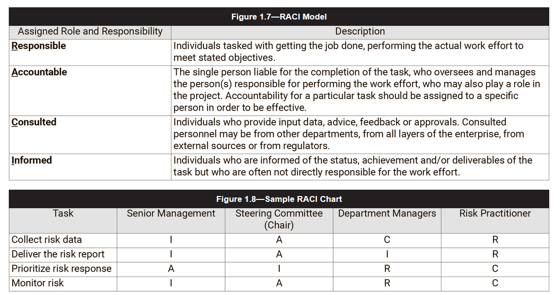

Slide 49
1.2.2 Key Roles
  Within the business function of risk management there are a number of key roles which should be clearly defined to prevent misunderstandings and miscommunication.
The key roles are:
  Risk manager” Responsible for ensuring that the risk management functions are carried out to support the enterprise's goals and objectives.
  Risk analyst” Responsible for the analysis, evaluation and assessment of identified threats faced by the enterprise.
  Risk owner" The individual in whom the enterprise has invested the authority and accountability for making risk-based decisions, and who owns the loss associated with a realized risk scenario.
  Control owner” The individual accountable for ensuring controls are designed, implemented and operating as planned to keep risk at an acceptable levels. This may also be the risk owner. This includes budgeting, staffing, design, implementation and monitoring of controls.
  Control steward” The individuals who are responsible for the routine management and maintenance of controls on behalf of the control owner and institute changes at the direction of the control owner.
  Subject matter experts” These are individuals who have an intimate knowledge and can provide valuable insight into specific areas (e.g., financial, IT, call center) within an organization as they relate to identified or perceived threats and risk to the enterprise; based upon their experience, understanding and expertise in their respective domain.

Slide 50
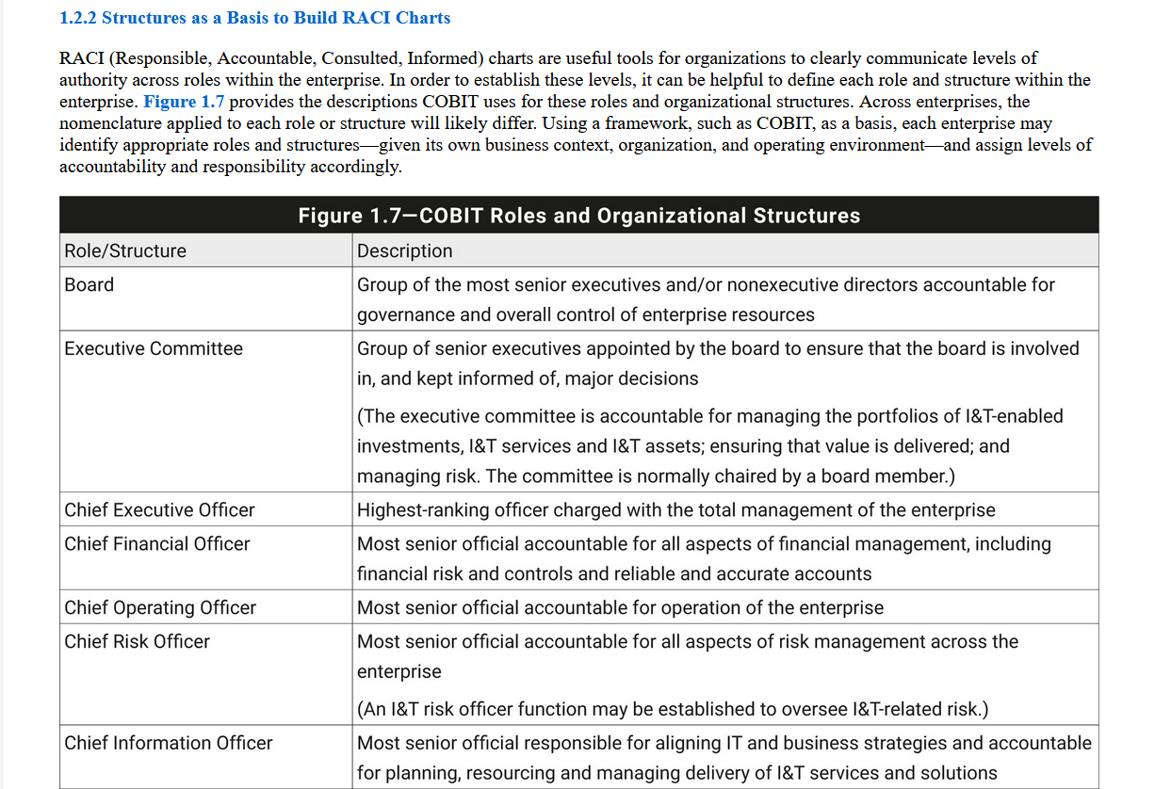

Slide 51
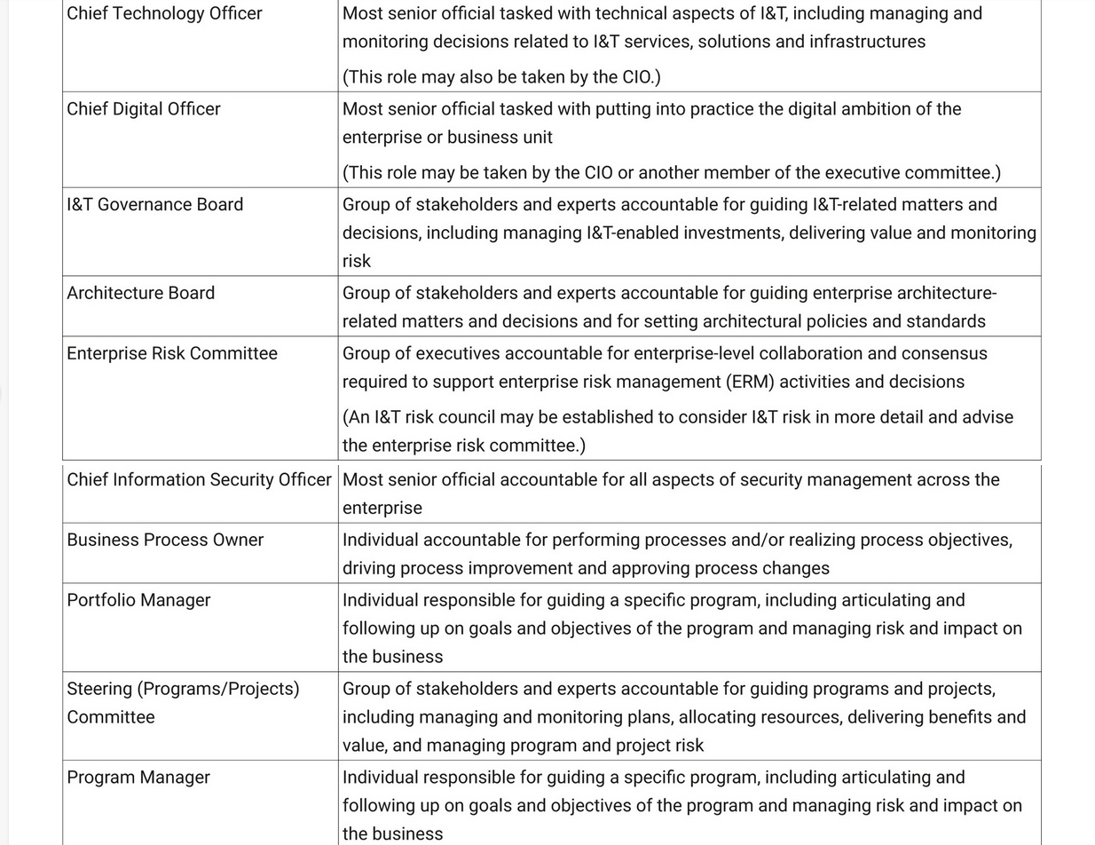

Slide 52
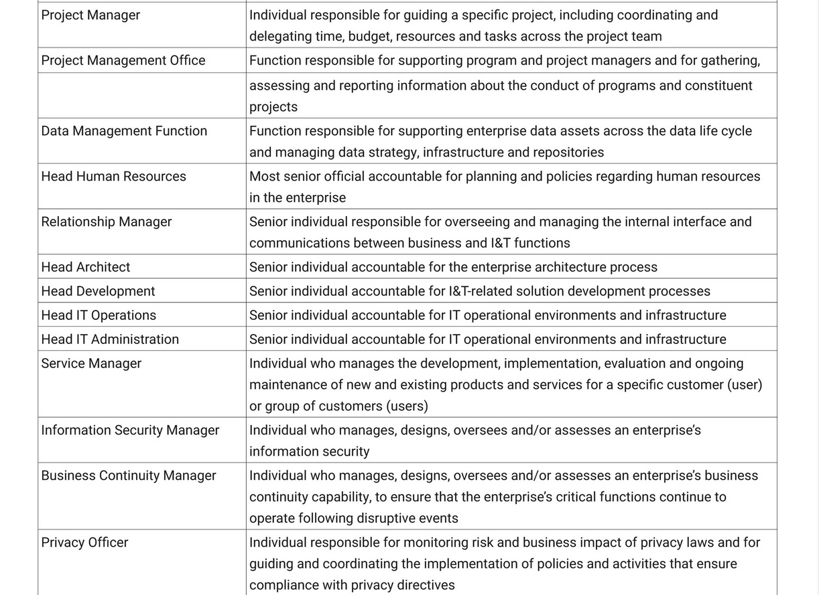

Slide 53
